Slide 1

MASTER THE TIDYVERSE
Mike K Smith
Winter 2020
Materials used in this course are derived from
https://github.com/rstudio-education/master-the-tidyverse/
and are shared under a CC-BY-SA-4.0 license.

Slide 2


HELLO
my name is
Mike
 @MikeKSmith
MikeKSmith
Mike.K.Smith@Pfizer.com
CC BY-SA RStudio
Notes:
* introduce yourself

Slide 3

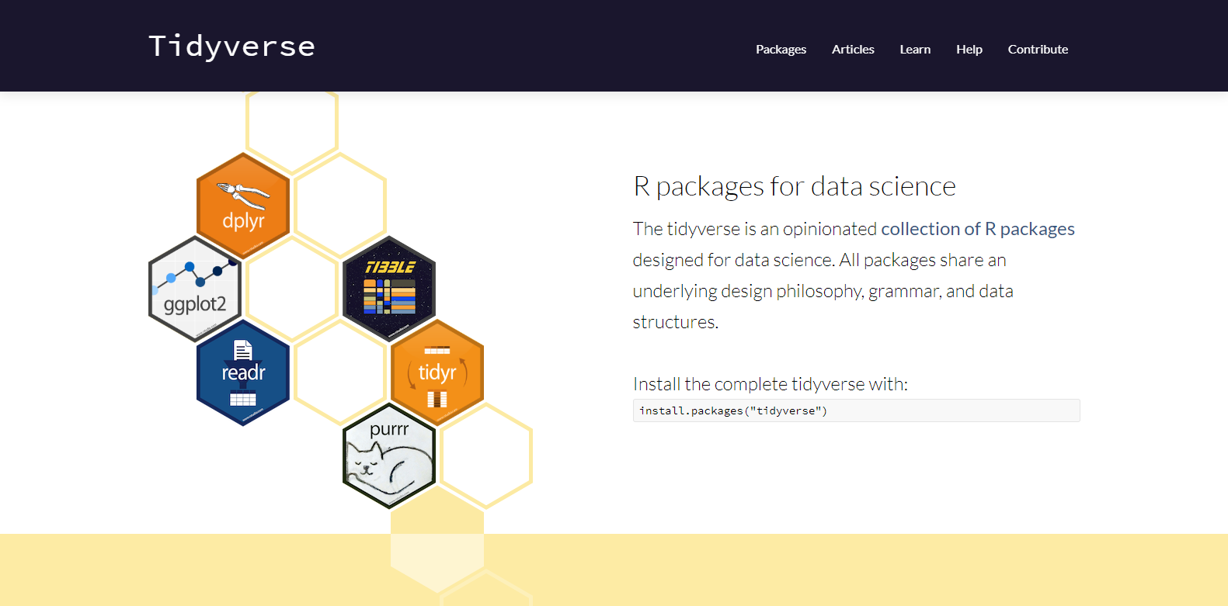
http://tidyverse.org
https://r4ds.had.co.nz/
CC BY-SA RStudio

Slide 4
Introduction and Visualize Data | 17th Jan
Transforming (subsetting) data | 24th Jan
Importing and reshaping data | 31st Jan
Data Types: strings, factors, date-times | 7th Feb
Iteration & Modelling | 14th Feb
Reproducible reporting | 21st Feb
CC BY-SA RStudio

Slide 5

Report Reproducibly with

Slide 6

R Markdown
Notes:
By the end of this section, I hope to have you write a few different outlines that you can use for different length workshops

Slide 7
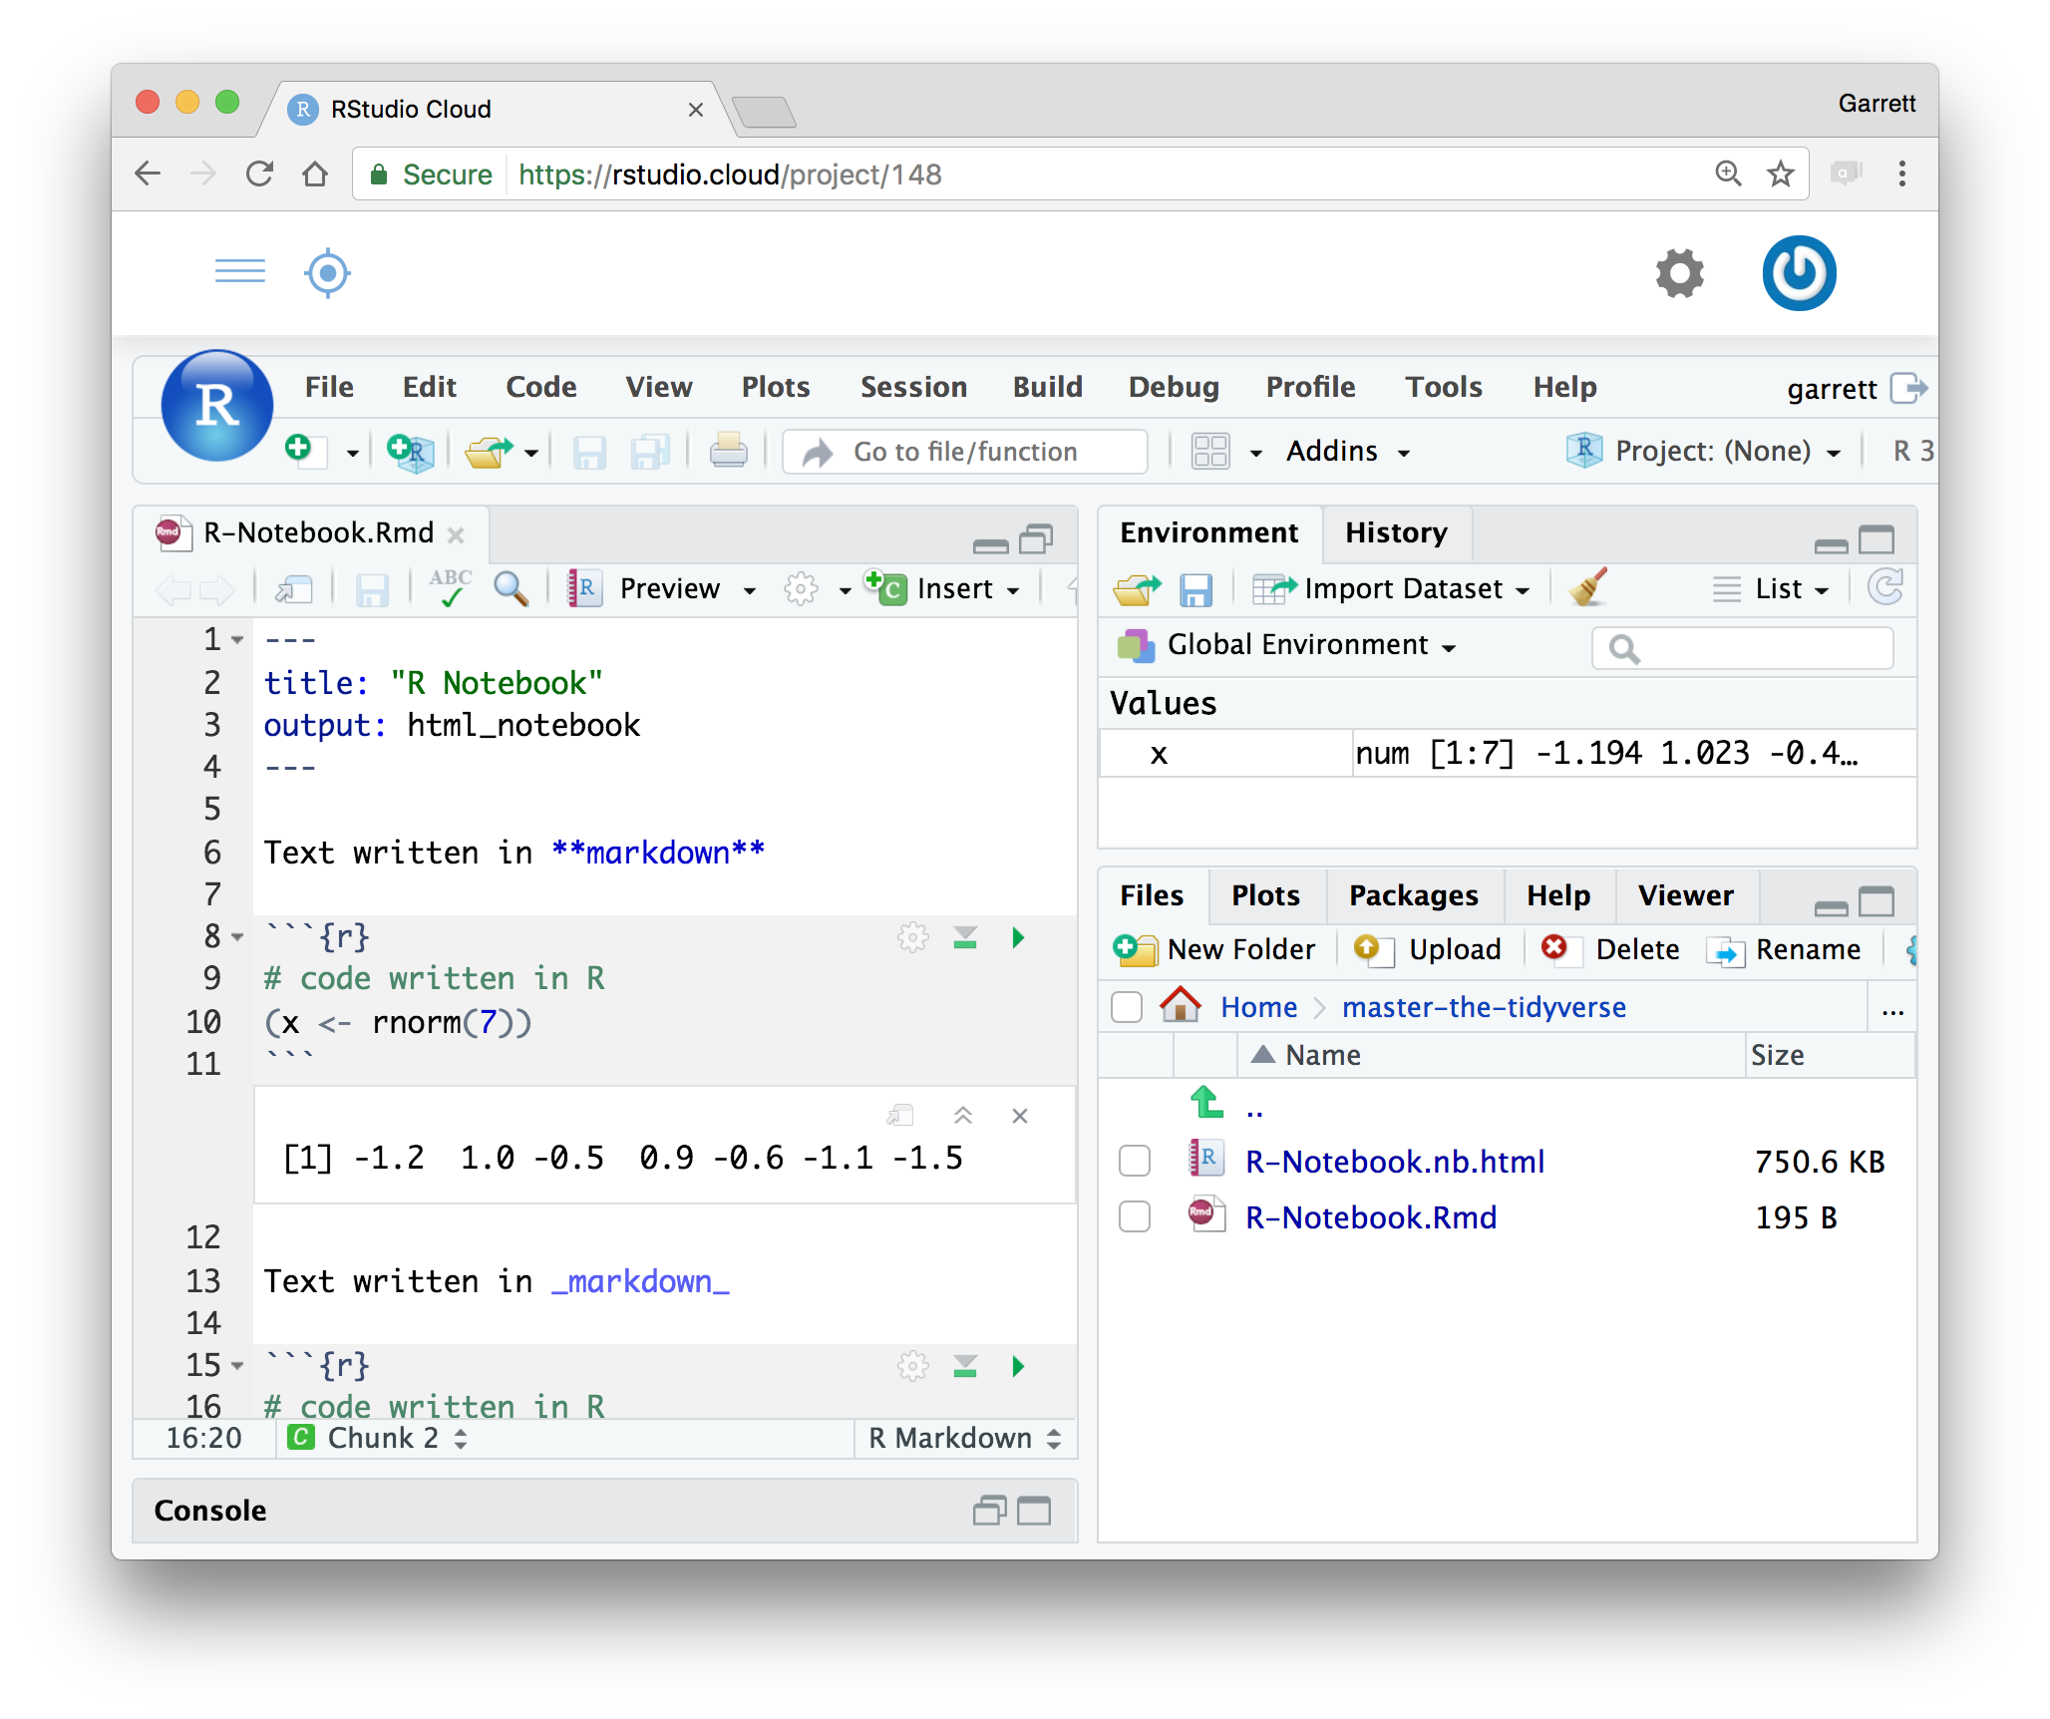
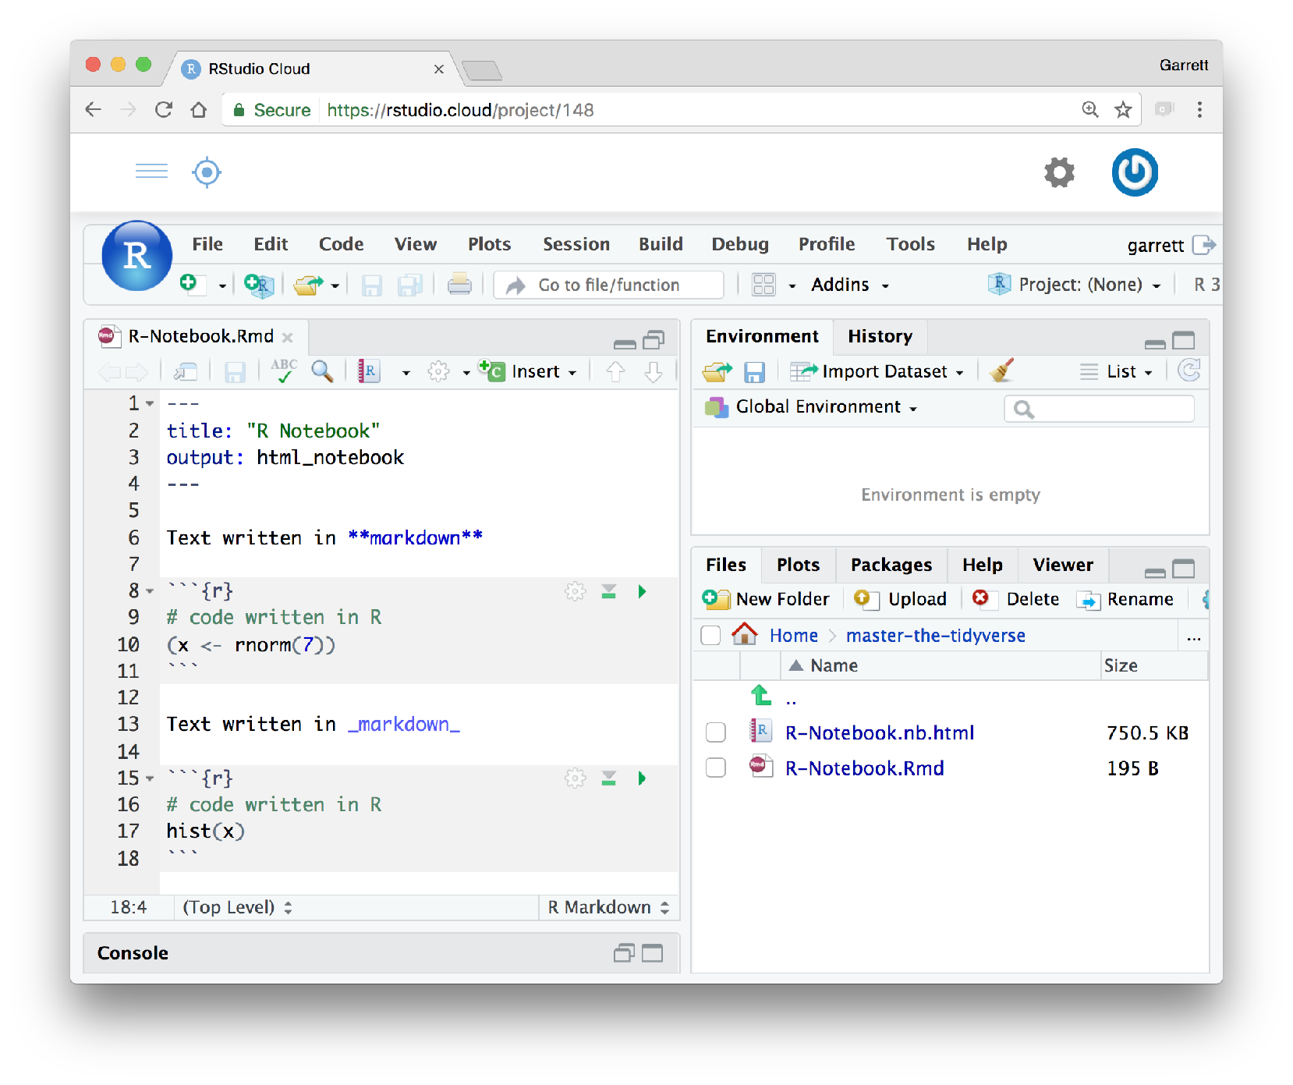
R Markdown
Plain text file with 3 types of content:
A YAML header surrounded by
— — —
Text in markdown
Code chunks surrounded by
```
CC BY-SA RStudio
Notes:
A learner persona is a detailed profile of a representative, but perhaps imaginary student.
The technique borrowed from UI designers.
Lesson design is all about putting yourself in your learner's shoes, and this is a helpful way to do that. It is all you will have to go on until you can start to get student/day of class feedback. A good learner persona should consist of five parts.
Here's an example persona written by Greg: "Jean is a professor of Computer Science whose research area is operating systems. She has been teaching undergraduate classes for six years, and increasingly believes there has to be a better way. The only training available through her university's teaching and learning center relates to posting assignments and grades in the learning management system, so she wants to find out what else she ought to be asking for."

Slide 8
How it works
Notes:
A technique borrowed from UI designers.
Lesson design is all about putting yourself in your learner's shoes, and this is a helpful way to do that. It is all you will have to go on until you can start to get student/day of class feedback.

Slide 9







knitr
pandoc
Rmd
md
ioslides
slidy, Beamer
Powerpoint
Microsoft Word
9
CC BY-SA RStudio
Notes:
A learner persona is a detailed profile of a representative, but perhaps imaginary student.
The technique borrowed from UI designers.
Lesson design is all about putting yourself in your learner's shoes, and this is a helpful way to do that. It is all you will have to go on until you can start to get student/day of class feedback. A good learner persona should consist of five parts.
Here's an example persona written by Greg: "Jean is a professor of Computer Science whose research area is operating systems. She has been teaching undergraduate classes for six years, and increasingly believes there has to be a better way. The only training available through her university's teaching and learning center relates to posting assignments and grades in the learning management system, so she wants to find out what else she ought to be asking for."

Slide 10
Logistics
Knitr runs the document in a fresh R session, which means you need to load the libraries that the document uses in the document
1
CC BY-SA RStudio
Notes:
A learner persona is a detailed profile of a representative, but perhaps imaginary student.
The technique borrowed from UI designers.
Lesson design is all about putting yourself in your learner's shoes, and this is a helpful way to do that. It is all you will have to go on until you can start to get student/day of class feedback. A good learner persona should consist of five parts.
Here's an example persona written by Greg: "Jean is a professor of Computer Science whose research area is operating systems. She has been teaching undergraduate classes for six years, and increasingly believes there has to be a better way. The only training available through her university's teaching and learning center relates to posting assignments and grades in the learning management system, so she wants to find out what else she ought to be asking for."

Slide 11
Logistics
Knitr runs the document in a fresh R session, which means you need to load the libraries that the document uses in the document
1
Objects made in one code chunk will be available to code in later code chunks.
2
CC BY-SA RStudio
Notes:
A learner persona is a detailed profile of a representative, but perhaps imaginary student.
The technique borrowed from UI designers.
Lesson design is all about putting yourself in your learner's shoes, and this is a helpful way to do that. It is all you will have to go on until you can start to get student/day of class feedback. A good learner persona should consist of five parts.
Here's an example persona written by Greg: "Jean is a professor of Computer Science whose research area is operating systems. She has been teaching undergraduate classes for six years, and increasingly believes there has to be a better way. The only training available through her university's teaching and learning center relates to posting assignments and grades in the learning management system, so she wants to find out what else she ought to be asking for."

Slide 12

knitr is
multi-lingual!
SAS
python
more
12
CC BY-SA RStudio
Notes:
A learner persona is a detailed profile of a representative, but perhaps imaginary student.
The technique borrowed from UI designers.
Lesson design is all about putting yourself in your learner's shoes, and this is a helpful way to do that. It is all you will have to go on until you can start to get student/day of class feedback. A good learner persona should consist of five parts.
Here's an example persona written by Greg: "Jean is a professor of Computer Science whose research area is operating systems. She has been teaching undergraduate classes for six years, and increasingly believes there has to be a better way. The only training available through her university's teaching and learning center relates to posting assignments and grades in the learning management system, so she wants to find out what else she ought to be asking for."

Slide 13
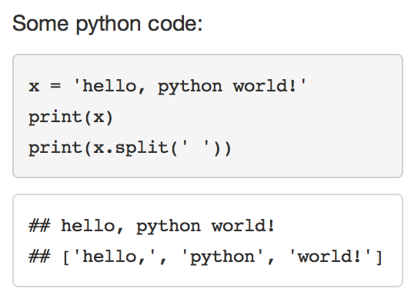
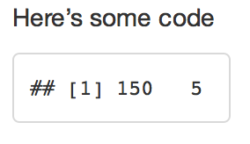
engine
To embed non R code, change the chunk label from r to the language to use.
python
Some python code,
```{python}
x = 'hello, python world!'
print(x)
print(x.split(' '))
```
CC BY-SA RStudio
Notes:
A learner persona is a detailed profile of a representative, but perhaps imaginary student.
The technique borrowed from UI designers.
Lesson design is all about putting yourself in your learner's shoes, and this is a helpful way to do that. It is all you will have to go on until you can start to get student/day of class feedback. A good learner persona should consist of five parts.
Here's an example persona written by Greg: "Jean is a professor of Computer Science whose research area is operating systems. She has been teaching undergraduate classes for six years, and increasingly believes there has to be a better way. The only training available through her university's teaching and learning center relates to posting assignments and grades in the learning management system, so she wants to find out what else she ought to be asking for."

Slide 14
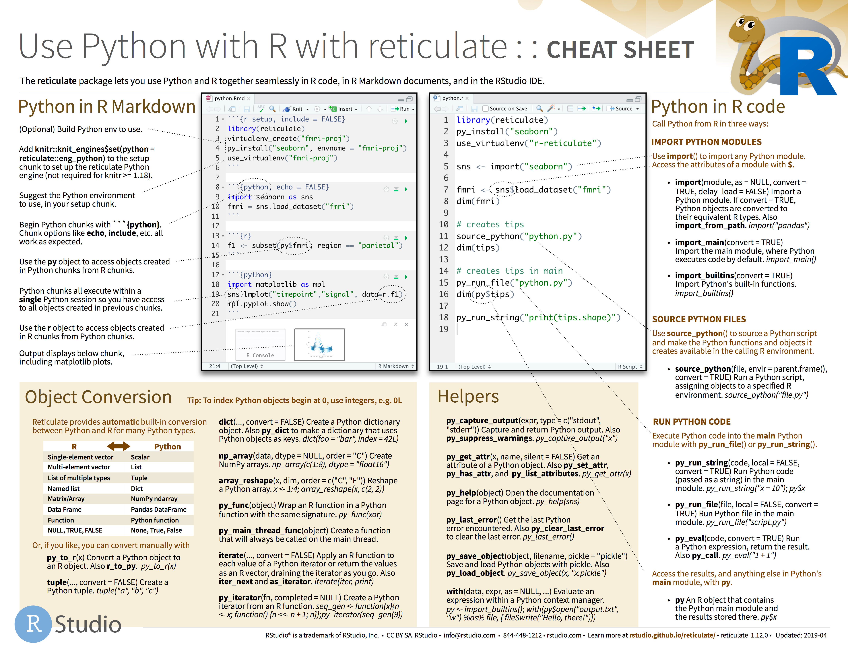
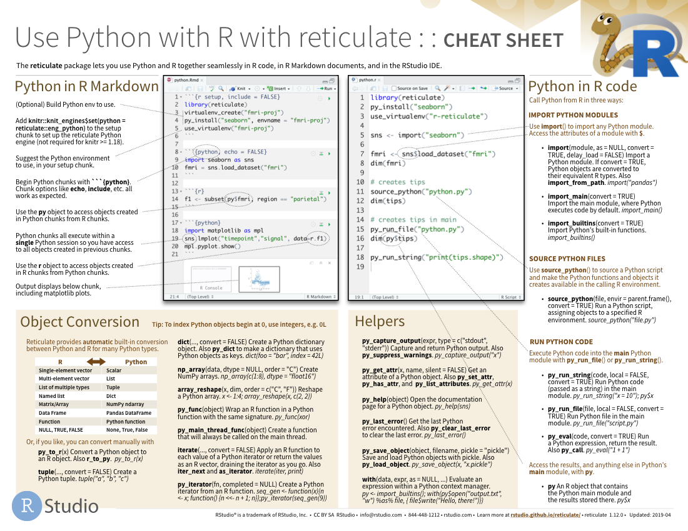
Reticulate
A package for using R and Python together.
14

Slide 15

bookdown.org/yihui/rmarkdown/
ONLINE, FREE
15
CC BY-SA RStudio
Notes:
A learner persona is a detailed profile of a representative, but perhaps imaginary student.
The technique borrowed from UI designers.
Lesson design is all about putting yourself in your learner's shoes, and this is a helpful way to do that. It is all you will have to go on until you can start to get student/day of class feedback. A good learner persona should consist of five parts.
Here's an example persona written by Greg: "Jean is a professor of Computer Science whose research area is operating systems. She has been teaching undergraduate classes for six years, and increasingly believes there has to be a better way. The only training available through her university's teaching and learning center relates to posting assignments and grades in the learning management system, so she wants to find out what else she ought to be asking for."

Slide 16
Markdown
Text in markdown
Notes:
A technique borrowed from UI designers.
Lesson design is all about putting yourself in your learner's shoes, and this is a helpful way to do that. It is all you will have to go on until you can start to get student/day of class feedback.

Slide 17
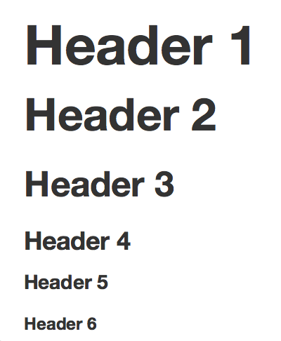
Headers
Use # to create headers.
Multiple #’s create lower level headers.
# Header 1
## Header 2
### Header 3
#### Header 4
##### Header 5
###### Header 6
17
CC BY-SA RStudio
Notes:
A learner persona is a detailed profile of a representative, but perhaps imaginary student.
The technique borrowed from UI designers.
Lesson design is all about putting yourself in your learner's shoes, and this is a helpful way to do that. It is all you will have to go on until you can start to get student/day of class feedback. A good learner persona should consist of five parts.
Here's an example persona written by Greg: "Jean is a professor of Computer Science whose research area is operating systems. She has been teaching undergraduate classes for six years, and increasingly believes there has to be a better way. The only training available through her university's teaching and learning center relates to posting assignments and grades in the learning management system, so she wants to find out what else she ought to be asking for."

Slide 18

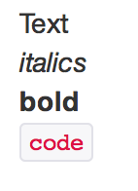
Text
Add two spaces at the end of a line to start a new line
Text is rendered as plain text. Surround text with _, **, or ` to format it.
Text
_italics_
**bold**
`code`
18
CC BY-SA RStudio
Notes:
A learner persona is a detailed profile of a representative, but perhaps imaginary student.
The technique borrowed from UI designers.
Lesson design is all about putting yourself in your learner's shoes, and this is a helpful way to do that. It is all you will have to go on until you can start to get student/day of class feedback. A good learner persona should consist of five parts.
Here's an example persona written by Greg: "Jean is a professor of Computer Science whose research area is operating systems. She has been teaching undergraduate classes for six years, and increasingly believes there has to be a better way. The only training available through her university's teaching and learning center relates to posting assignments and grades in the learning management system, so she wants to find out what else she ought to be asking for."

Slide 19
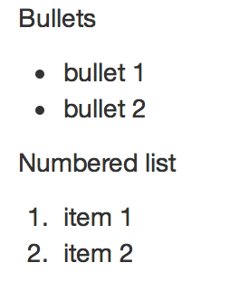
Lists
Use asterisks to make bullet points.
Use numbers to make numbered lists.
Bullets
* bullet 1
* bullet 2
Numbered list
1. item 1
2. item 2
19
CC BY-SA RStudio
Notes:
A learner persona is a detailed profile of a representative, but perhaps imaginary student.
The technique borrowed from UI designers.
Lesson design is all about putting yourself in your learner's shoes, and this is a helpful way to do that. It is all you will have to go on until you can start to get student/day of class feedback. A good learner persona should consist of five parts.
Here's an example persona written by Greg: "Jean is a professor of Computer Science whose research area is operating systems. She has been teaching undergraduate classes for six years, and increasingly believes there has to be a better way. The only training available through her university's teaching and learning center relates to posting assignments and grades in the learning management system, so she wants to find out what else she ought to be asking for."

Slide 20
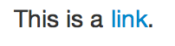
Hyperlinks
Use brackets to denote a link. Place the URL in parentheses.
This is a
[link](www.git.com).
20
CC BY-SA RStudio
Notes:
A learner persona is a detailed profile of a representative, but perhaps imaginary student.
The technique borrowed from UI designers.
Lesson design is all about putting yourself in your learner's shoes, and this is a helpful way to do that. It is all you will have to go on until you can start to get student/day of class feedback. A good learner persona should consist of five parts.
Here's an example persona written by Greg: "Jean is a professor of Computer Science whose research area is operating systems. She has been teaching undergraduate classes for six years, and increasingly believes there has to be a better way. The only training available through her university's teaching and learning center relates to posting assignments and grades in the learning management system, so she wants to find out what else she ought to be asking for."

Slide 21

Images
Use a link preceded by an ! to insert an image.
The link text should be a URL (if the image is hosted online), or a file path (if the image is saved as a file)
![](images/1.png)
The RStudio logo.
21
CC BY-SA RStudio
Notes:
A learner persona is a detailed profile of a representative, but perhaps imaginary student.
The technique borrowed from UI designers.
Lesson design is all about putting yourself in your learner's shoes, and this is a helpful way to do that. It is all you will have to go on until you can start to get student/day of class feedback. A good learner persona should consist of five parts.
Here's an example persona written by Greg: "Jean is a professor of Computer Science whose research area is operating systems. She has been teaching undergraduate classes for six years, and increasingly believes there has to be a better way. The only training available through her university's teaching and learning center relates to posting assignments and grades in the learning management system, so she wants to find out what else she ought to be asking for."

Slide 22
Images
Better – use knitr::include_graphic( ).
More control over sizing from chunk options.
```{r include_graphic}
include_graphics(“1.png”)
```
http://zevross.com/blog/2017/06/19/tips-and-tricks-for-working-with-images-and-figures-in-r-markdown-documents/
22
CC BY-SA RStudio
Notes:
A learner persona is a detailed profile of a representative, but perhaps imaginary student.
The technique borrowed from UI designers.
Lesson design is all about putting yourself in your learner's shoes, and this is a helpful way to do that. It is all you will have to go on until you can start to get student/day of class feedback. A good learner persona should consist of five parts.
Here's an example persona written by Greg: "Jean is a professor of Computer Science whose research area is operating systems. She has been teaching undergraduate classes for six years, and increasingly believes there has to be a better way. The only training available through her university's teaching and learning center relates to posting assignments and grades in the learning management system, so she wants to find out what else she ought to be asking for."

Slide 23
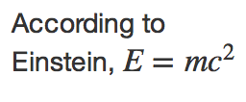
Equations
Write equations with latex math commands and surround them in $’s.
According to Einstein, $E=mc^{2}$
23
CC BY-SA RStudio
Notes:
A learner persona is a detailed profile of a representative, but perhaps imaginary student.
The technique borrowed from UI designers.
Lesson design is all about putting yourself in your learner's shoes, and this is a helpful way to do that. It is all you will have to go on until you can start to get student/day of class feedback. A good learner persona should consist of five parts.
Here's an example persona written by Greg: "Jean is a professor of Computer Science whose research area is operating systems. She has been teaching undergraduate classes for six years, and increasingly believes there has to be a better way. The only training available through her university's teaching and learning center relates to posting assignments and grades in the learning management system, so she wants to find out what else she ought to be asking for."

Slide 24
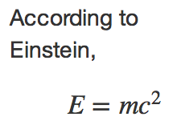
Equation blocks
Use two $’s to make centered equation blocks.
According to Einstein,
$$E=mc^{2}$$
24
CC BY-SA RStudio
Notes:
A learner persona is a detailed profile of a representative, but perhaps imaginary student.
The technique borrowed from UI designers.
Lesson design is all about putting yourself in your learner's shoes, and this is a helpful way to do that. It is all you will have to go on until you can start to get student/day of class feedback. A good learner persona should consist of five parts.
Here's an example persona written by Greg: "Jean is a professor of Computer Science whose research area is operating systems. She has been teaching undergraduate classes for six years, and increasingly believes there has to be a better way. The only training available through her university's teaching and learning center relates to posting assignments and grades in the learning management system, so she wants to find out what else she ought to be asking for."

Slide 25
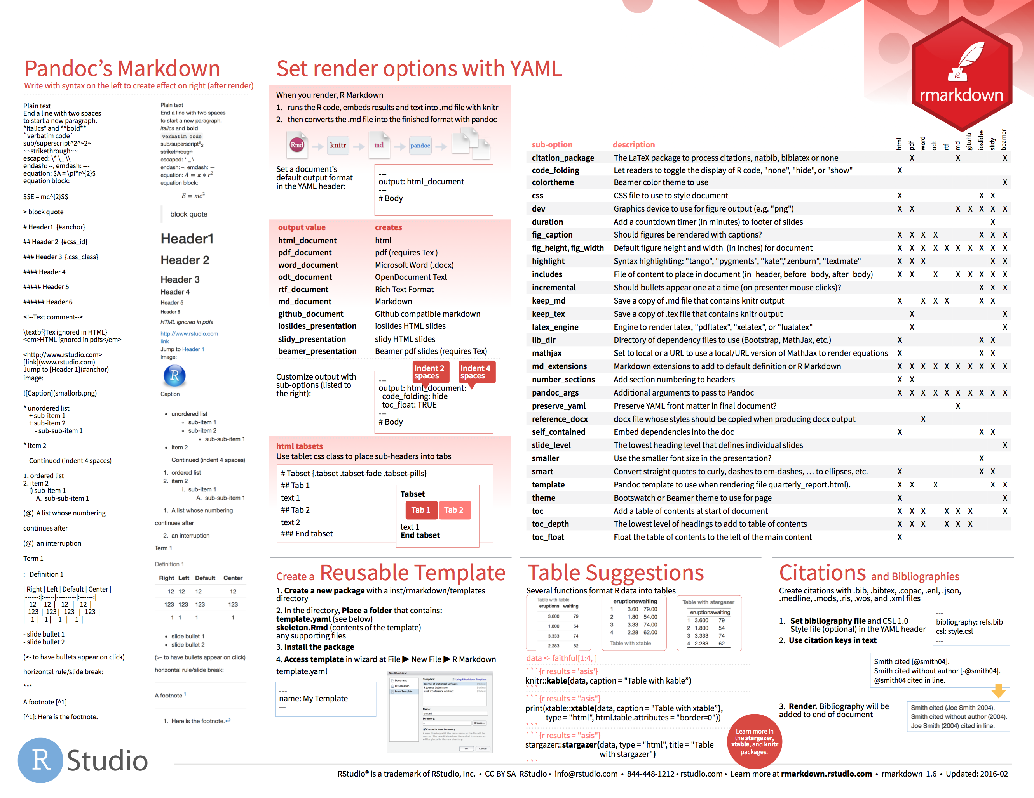

Markdown
Dictionary of formatting cues.
on back of RMarkdown cheat sheet
25

Slide 26
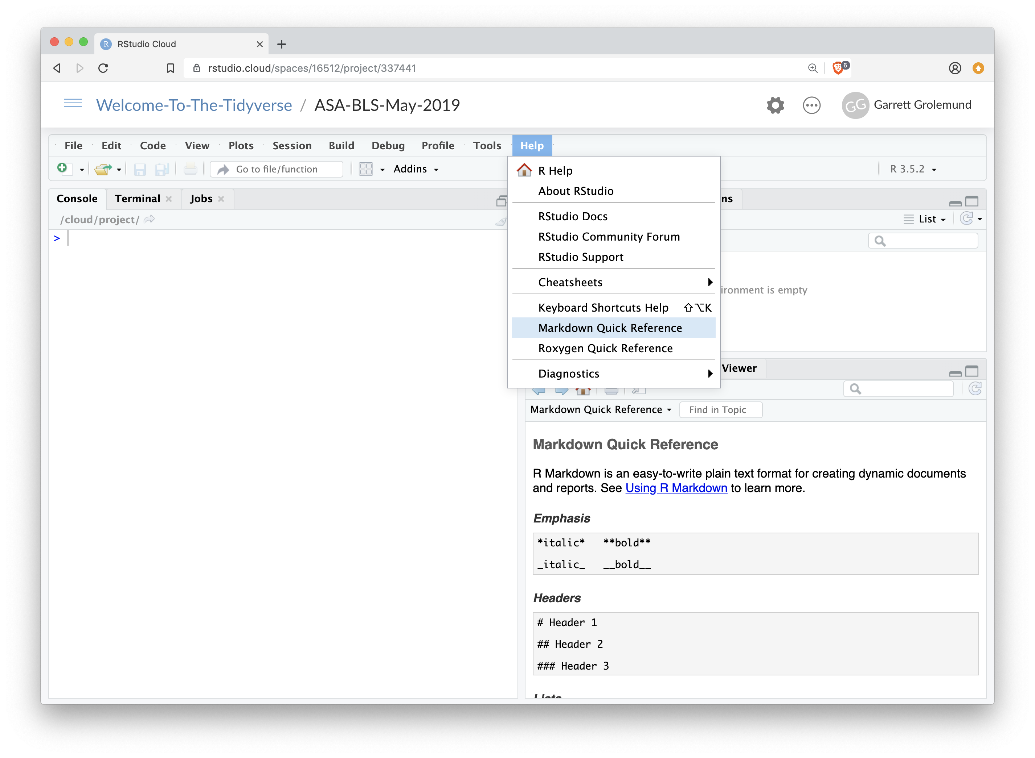

IDE Reference
Go to Help > Markdown Quick Reference
opens here

Slide 27
Code
Code chunks surrounded by ```
Notes:
A technique borrowed from UI designers.
Lesson design is all about putting yourself in your learner's shoes, and this is a helpful way to do that. It is all you will have to go on until you can start to get student/day of class feedback.

Slide 28
Code chunks
Insert a chunk of R code with
When you render the report, R Markdown will run the code and include its results. R Markdown will also remove the ```{r} and ```.
```{r}
# some code
```
28
CC BY-SA RStudio
Notes:
A learner persona is a detailed profile of a representative, but perhaps imaginary student.
The technique borrowed from UI designers.
Lesson design is all about putting yourself in your learner's shoes, and this is a helpful way to do that. It is all you will have to go on until you can start to get student/day of class feedback. A good learner persona should consist of five parts.
Here's an example persona written by Greg: "Jean is a professor of Computer Science whose research area is operating systems. She has been teaching undergraduate classes for six years, and increasingly believes there has to be a better way. The only training available through her university's teaching and learning center relates to posting assignments and grades in the learning management system, so she wants to find out what else she ought to be asking for."

Slide 29
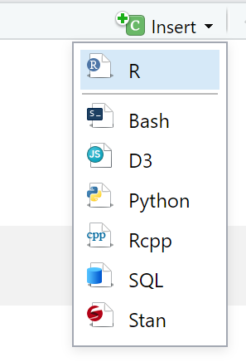
Code chunks
Insert a chunk of R code with
```{r}
# some code
```
CC BY-SA RStudio
Notes:
A learner persona is a detailed profile of a representative, but perhaps imaginary student.
The technique borrowed from UI designers.
Lesson design is all about putting yourself in your learner's shoes, and this is a helpful way to do that. It is all you will have to go on until you can start to get student/day of class feedback. A good learner persona should consist of five parts.
Here's an example persona written by Greg: "Jean is a professor of Computer Science whose research area is operating systems. She has been teaching undergraduate classes for six years, and increasingly believes there has to be a better way. The only training available through her university's teaching and learning center relates to posting assignments and grades in the learning management system, so she wants to find out what else she ought to be asking for."

Slide 30
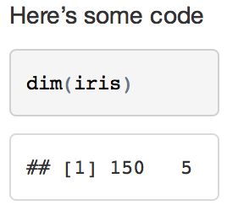
chunk options
By default, R Markdown includes both the code and its results
Here’s some code
```{r}
dim(iris)
```
30
CC BY-SA RStudio
Notes:
A learner persona is a detailed profile of a representative, but perhaps imaginary student.
The technique borrowed from UI designers.
Lesson design is all about putting yourself in your learner's shoes, and this is a helpful way to do that. It is all you will have to go on until you can start to get student/day of class feedback. A good learner persona should consist of five parts.
Here's an example persona written by Greg: "Jean is a professor of Computer Science whose research area is operating systems. She has been teaching undergraduate classes for six years, and increasingly believes there has to be a better way. The only training available through her university's teaching and learning center relates to posting assignments and grades in the learning management system, so she wants to find out what else she ought to be asking for."

Slide 31
echo
Add options in the brackets after r.
echo = FALSE hides the code.
Here’s some code
```{r echo=FALSE}
dim(iris)
```
Very useful
for plots
31
CC BY-SA RStudio
Notes:
A learner persona is a detailed profile of a representative, but perhaps imaginary student.
The technique borrowed from UI designers.
Lesson design is all about putting yourself in your learner's shoes, and this is a helpful way to do that. It is all you will have to go on until you can start to get student/day of class feedback. A good learner persona should consist of five parts.
Here's an example persona written by Greg: "Jean is a professor of Computer Science whose research area is operating systems. She has been teaching undergraduate classes for six years, and increasingly believes there has to be a better way. The only training available through her university's teaching and learning center relates to posting assignments and grades in the learning management system, so she wants to find out what else she ought to be asking for."

Slide 32
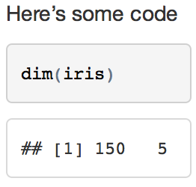
eval
eval = FALSE prevents the code from being run. As a result, no results will be displayed with the code.
Here’s some code
```{r eval=FALSE}
dim(iris)
```
32
CC BY-SA RStudio
Notes:
A learner persona is a detailed profile of a representative, but perhaps imaginary student.
The technique borrowed from UI designers.
Lesson design is all about putting yourself in your learner's shoes, and this is a helpful way to do that. It is all you will have to go on until you can start to get student/day of class feedback. A good learner persona should consist of five parts.
Here's an example persona written by Greg: "Jean is a professor of Computer Science whose research area is operating systems. She has been teaching undergraduate classes for six years, and increasingly believes there has to be a better way. The only training available through her university's teaching and learning center relates to posting assignments and grades in the learning management system, so she wants to find out what else she ought to be asking for."

Slide 33
include
include = FALSE runs the code, but prevents both the code and the results from appearing.
Here’s some code
```{r include=FALSE}
dim(iris)
```
33
CC BY-SA RStudio
Notes:
A learner persona is a detailed profile of a representative, but perhaps imaginary student.
The technique borrowed from UI designers.
Lesson design is all about putting yourself in your learner's shoes, and this is a helpful way to do that. It is all you will have to go on until you can start to get student/day of class feedback. A good learner persona should consist of five parts.
Here's an example persona written by Greg: "Jean is a professor of Computer Science whose research area is operating systems. She has been teaching undergraduate classes for six years, and increasingly believes there has to be a better way. The only training available through her university's teaching and learning center relates to posting assignments and grades in the learning management system, so she wants to find out what else she ought to be asking for."

Slide 34
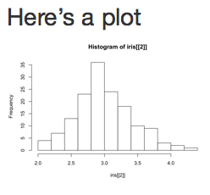
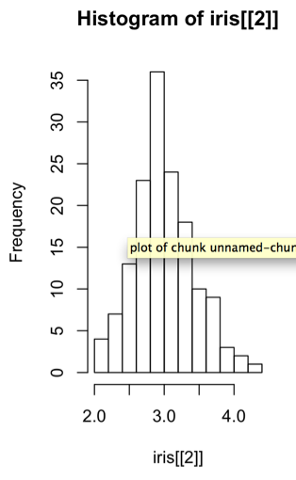
fig.height, fig.width
Specify the dimension of plots (in inches) with fig.width and fig.height. Separate multiple arguments with commas.
Here’s a plot
```{r echo=FALSE, fig.width=3, fig.height=5}
hist(iris[[2]])
```
34
CC BY-SA RStudio
Notes:
A learner persona is a detailed profile of a representative, but perhaps imaginary student.
The technique borrowed from UI designers.
Lesson design is all about putting yourself in your learner's shoes, and this is a helpful way to do that. It is all you will have to go on until you can start to get student/day of class feedback. A good learner persona should consist of five parts.
Here's an example persona written by Greg: "Jean is a professor of Computer Science whose research area is operating systems. She has been teaching undergraduate classes for six years, and increasingly believes there has to be a better way. The only training available through her university's teaching and learning center relates to posting assignments and grades in the learning management system, so she wants to find out what else she ought to be asking for."

Slide 35
Images
```{r include_graphic}
include_graphics(“1.png”)
```
http://zevross.com/blog/2017/06/19/tips-and-tricks-for-working-with-images-and-figures-in-r-markdown-documents/
35
CC BY-SA RStudio
Notes:
A learner persona is a detailed profile of a representative, but perhaps imaginary student.
The technique borrowed from UI designers.
Lesson design is all about putting yourself in your learner's shoes, and this is a helpful way to do that. It is all you will have to go on until you can start to get student/day of class feedback. A good learner persona should consist of five parts.
Here's an example persona written by Greg: "Jean is a professor of Computer Science whose research area is operating systems. She has been teaching undergraduate classes for six years, and increasingly believes there has to be a better way. The only training available through her university's teaching and learning center relates to posting assignments and grades in the learning management system, so she wants to find out what else she ought to be asking for."

Slide 36
Set options for ALL chunks
Use the knitr function opts_chunk to define options for ALL chunks in the markdown document
```{r setup, include = FALSE}
knitr::opts_chunk$set(echo = TRUE)
```
36
CC BY-SA RStudio
Notes:
A learner persona is a detailed profile of a representative, but perhaps imaginary student.
The technique borrowed from UI designers.
Lesson design is all about putting yourself in your learner's shoes, and this is a helpful way to do that. It is all you will have to go on until you can start to get student/day of class feedback. A good learner persona should consist of five parts.
Here's an example persona written by Greg: "Jean is a professor of Computer Science whose research area is operating systems. She has been teaching undergraduate classes for six years, and increasingly believes there has to be a better way. The only training available through her university's teaching and learning center relates to posting assignments and grades in the learning management system, so she wants to find out what else she ought to be asking for."

Slide 37
Inline code
Code whose results are inserted into the text.
Today is `r Sys.Date()`.
Surround with `r `
Code to run. Only the result will be included.
37
CC BY-SA RStudio
Notes:
A learner persona is a detailed profile of a representative, but perhaps imaginary student.
The technique borrowed from UI designers.
Lesson design is all about putting yourself in your learner's shoes, and this is a helpful way to do that. It is all you will have to go on until you can start to get student/day of class feedback. A good learner persona should consist of five parts.
Here's an example persona written by Greg: "Jean is a professor of Computer Science whose research area is operating systems. She has been teaching undergraduate classes for six years, and increasingly believes there has to be a better way. The only training available through her university's teaching and learning center relates to posting assignments and grades in the learning management system, so she wants to find out what else she ought to be asking for."

Slide 38

Your Turn 1
In 09_Report.Rmd:
Replace every instance of Garrett with your name
Replace every TODO with inline R code
Check that the setup chunk is not included with the output
Ensure that only the output of the plot chunk is shown (not the code)
Knit the document
38

Slide 39
YAML
A YAML header surrounded by
— — —
YAML =
Yet
Another
Markup
Language
Notes:
A technique borrowed from UI designers.
Lesson design is all about putting yourself in your learner's shoes, and this is a helpful way to do that. It is all you will have to go on until you can start to get student/day of class feedback.

Slide 40
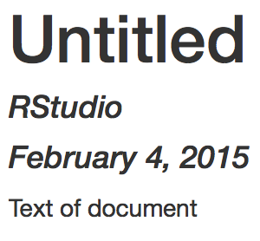
YAML
A section of key:value pairs.
CAUTION: Spaces matter in YAML
---
title: "Untitled"
author: "RStudio"
date: "February 4, 2015"
output: html_document
---
Text of document
CC BY-SA RStudio
Notes:
A learner persona is a detailed profile of a representative, but perhaps imaginary student.
The technique borrowed from UI designers.
Lesson design is all about putting yourself in your learner's shoes, and this is a helpful way to do that. It is all you will have to go on until you can start to get student/day of class feedback. A good learner persona should consist of five parts.
Here's an example persona written by Greg: "Jean is a professor of Computer Science whose research area is operating systems. She has been teaching undergraduate classes for six years, and increasingly believes there has to be a better way. The only training available through her university's teaching and learning center relates to posting assignments and grades in the learning management system, so she wants to find out what else she ought to be asking for."

Slide 41
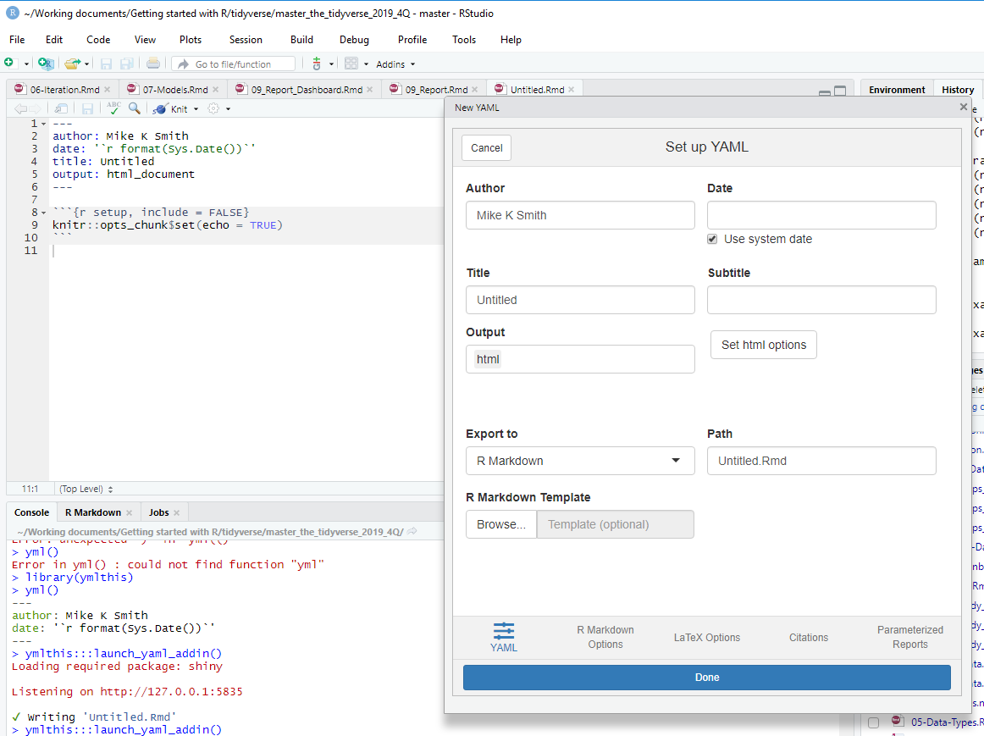
ymlthis
A package to assist writing the YAML header
https://ymlthis.r-lib.org/

Slide 42
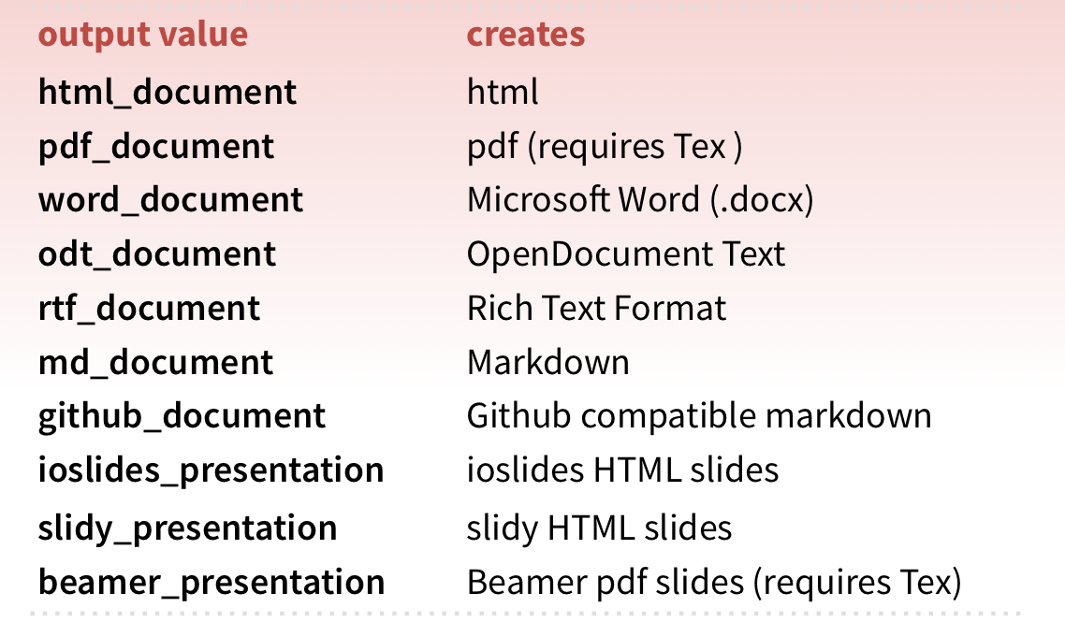
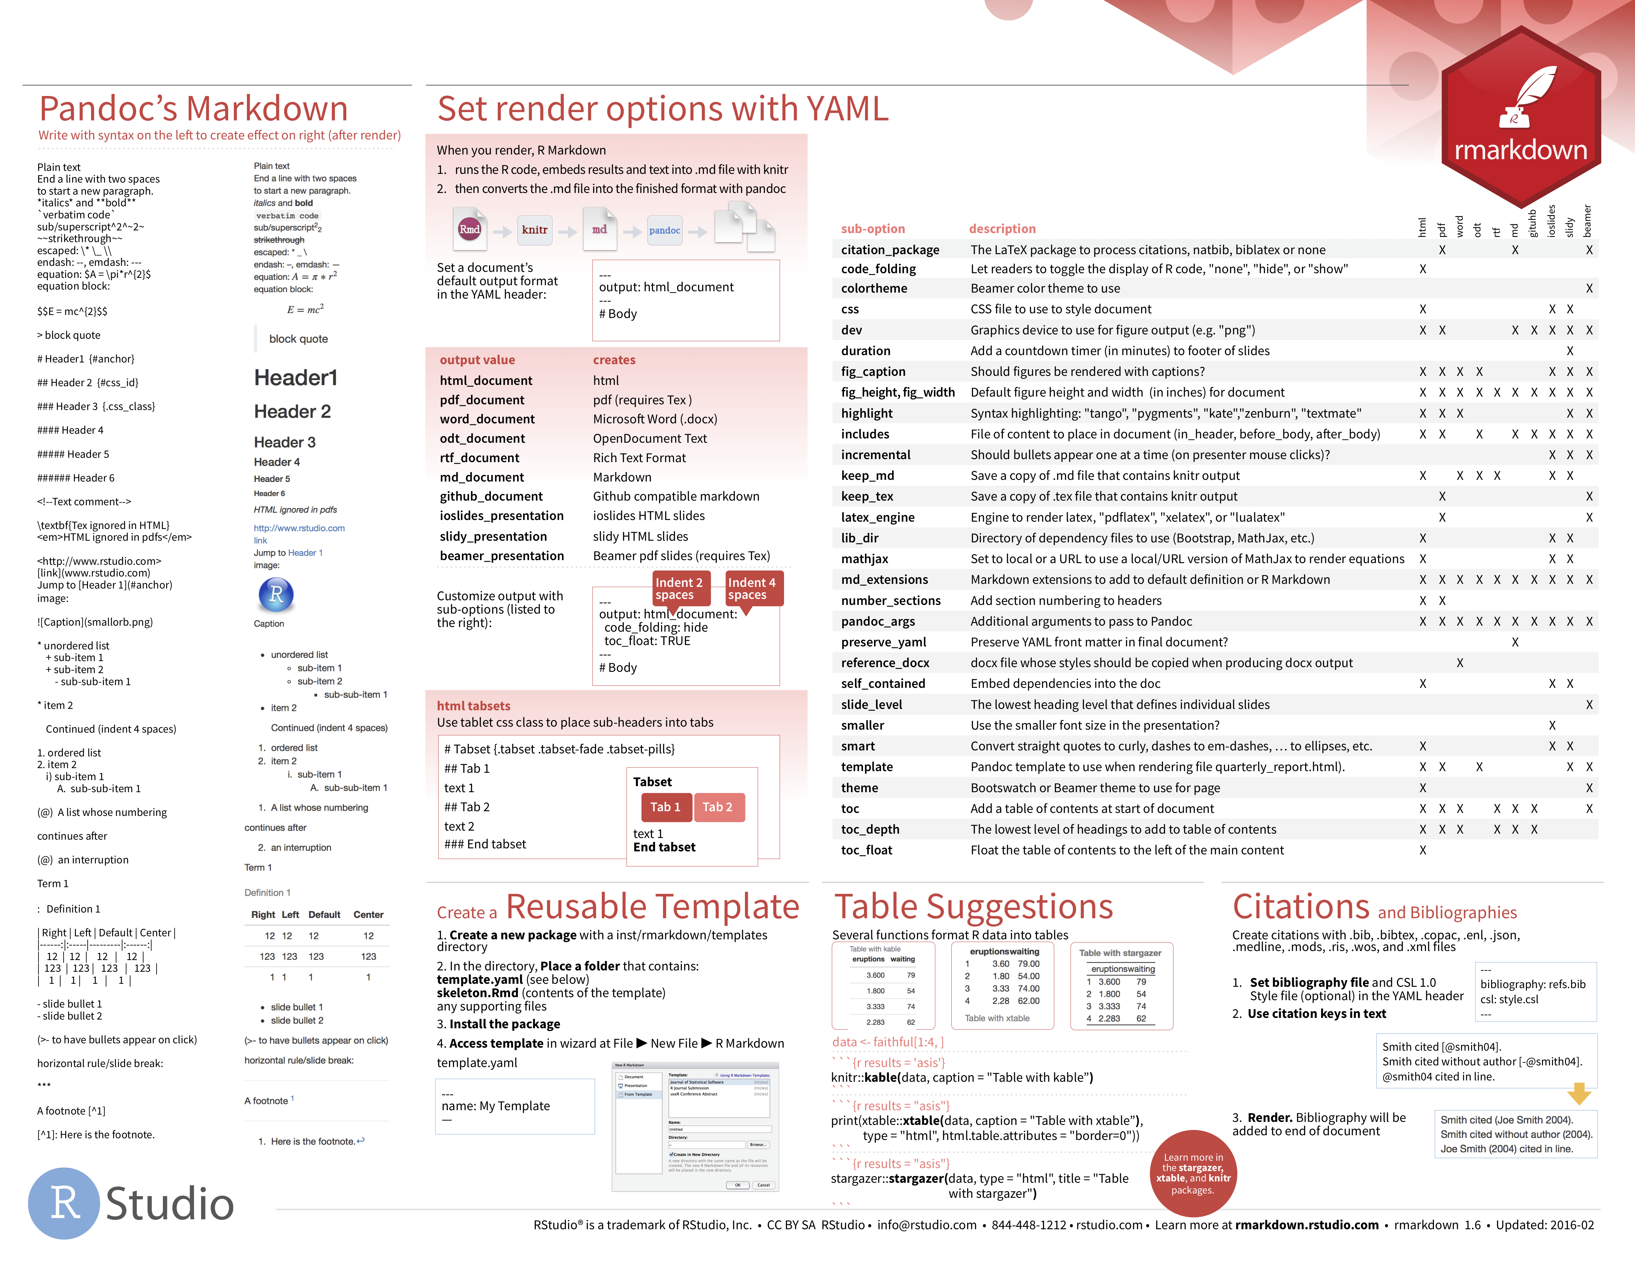
output
The output: field sets the format of the final report
on back
More at rmarkdown.rstudio.com/formats.html
CC BY-SA RStudio
Notes:
A learner persona is a detailed profile of a representative, but perhaps imaginary student.
The technique borrowed from UI designers.
Lesson design is all about putting yourself in your learner's shoes, and this is a helpful way to do that. It is all you will have to go on until you can start to get student/day of class feedback. A good learner persona should consist of five parts.
Here's an example persona written by Greg: "Jean is a professor of Computer Science whose research area is operating systems. She has been teaching undergraduate classes for six years, and increasingly believes there has to be a better way. The only training available through her university's teaching and learning center relates to posting assignments and grades in the learning management system, so she wants to find out what else she ought to be asking for."

Slide 43
Parameters
Notes:
A technique borrowed from UI designers.
Lesson design is all about putting yourself in your learner's shoes, and this is a helpful way to do that. It is all you will have to go on until you can start to get student/day of class feedback.

Slide 44

Your Turn 2
Open 09_Report_Parameters.Rmd.
Click the dropdown menu next to Knit and use Knit with Parameters to render the document.
What happens if you type in a different name?
44

Slide 45
Parameters
A list of values that you can call in R code chunks
---
title: "Untitled"
output: html_document
params:
filename: "data.csv"
symbol: "FB"
---
colon
params list
New line. Indented two spaces
elements and values
45
CC BY-SA RStudio
Notes:
A learner persona is a detailed profile of a representative, but perhaps imaginary student.
The technique borrowed from UI designers.
Lesson design is all about putting yourself in your learner's shoes, and this is a helpful way to do that. It is all you will have to go on until you can start to get student/day of class feedback. A good learner persona should consist of five parts.
Here's an example persona written by Greg: "Jean is a professor of Computer Science whose research area is operating systems. She has been teaching undergraduate classes for six years, and increasingly believes there has to be a better way. The only training available through her university's teaching and learning center relates to posting assignments and grades in the learning management system, so she wants to find out what else she ought to be asking for."

Slide 46
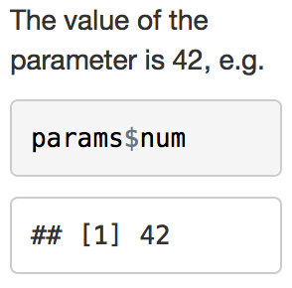
Using Parameters
Call parameter values as elements of the params list, params$num
---
params:
num: 42
---
The value of the parameter is
`r params$num`, e.g.
```{r}
params$num
```
46
CC BY-SA RStudio
Notes:
A learner persona is a detailed profile of a representative, but perhaps imaginary student.
The technique borrowed from UI designers.
Lesson design is all about putting yourself in your learner's shoes, and this is a helpful way to do that. It is all you will have to go on until you can start to get student/day of class feedback. A good learner persona should consist of five parts.
Here's an example persona written by Greg: "Jean is a professor of Computer Science whose research area is operating systems. She has been teaching undergraduate classes for six years, and increasingly believes there has to be a better way. The only training available through her university's teaching and learning center relates to posting assignments and grades in the learning management system, so she wants to find out what else she ought to be asking for."

Slide 47
names <- c("Alice", "Bob", "Cathy")
for (name in names) {
render("09_Report_Parameters.Rmd",
params = list(data = name))
}
render() + for
CC BY-SA RStudio
Notes:
A learner persona is a detailed profile of a representative, but perhaps imaginary student.
The technique borrowed from UI designers.
Lesson design is all about putting yourself in your learner's shoes, and this is a helpful way to do that. It is all you will have to go on until you can start to get student/day of class feedback. A good learner persona should consist of five parts.
Here's an example persona written by Greg: "Jean is a professor of Computer Science whose research area is operating systems. She has been teaching undergraduate classes for six years, and increasingly believes there has to be a better way. The only training available through her university's teaching and learning center relates to posting assignments and grades in the learning management system, so she wants to find out what else she ought to be asking for."

Slide 48
Report Reproducibly with

